Slide 1
Spooooooky SQL
PASS Speaker Idol 2019
William Assaf

Slide 2
Spooky SQL Stories
SCARY nonsequential newsequentialid() GUIDs
SHOCKING foreign key behavior
TERRIFYING duplicate primary keys
Features of night, brought to light!

Slide 4
Fright #1
Behold, the fright of the newsequentialid()!

Slide 5
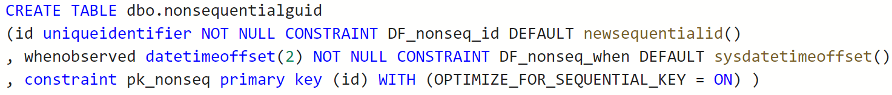
Consequential newsequentialid()
To set the stage …

Slide 6
Consequential newsequentialid()
Ran some inserts, caused some things to happen, and then…

Slide 7
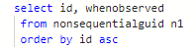
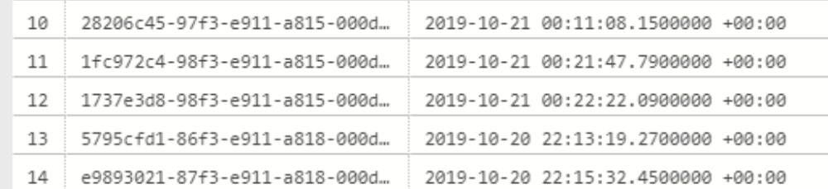
Consequential newsequentialid()

Slide 8
INSERT SORT ORDER
Expected behavior
of newsequentialid()
Actual behavior
when seed changes
Server change!
Server change!
Server change!
Server change!
Server change!
Server change!
Server change!
No Fragmentation
Fragmentation Upon Insertion

Slide 9
Consequential Nonsequential
The C++ function UuidCreateSequential is based on the MAC address of the NIC.
“Never use to identify an object that is not strictly local to your computer.“ https://docs.microsoft.com/en-us/windows/win32/api/rpcdce/nf-rpcdce-uuidcreatesequential
Any change to the MAC will change the newsequentialid() seed!

Slide 10
How could this happen?
Any Failover to FCI or AG
Upgrade or Migration to new hardware
Upgrade or Migration to new platform
Change the tier of Azure SQL DB
Reimage an Azure VM with ephemeral OS
Docker run without explicit MAC
Really any change to the server NIC MAC

Slide 11
MAC change could even happen on startup!
VMWare: “The MAC address of a powered-off virtual machine is not remembered. Thus it is possible that when a virtual machine is powered on again it can get a different MAC address.” https://kb.vmware.com/s/article/219
“Hyper-V will generate an initial MAC address for the network adapter, and it will regenerate the MAC address if it believes it is necessary.” https://blogs.msdn.microsoft.com/virtual_pc_guy/2010/05/14/hyper-v-and-dynamic-mac-address-regeneration/

Slide 13
Fright #2
Behold, the shocking foreign keys behavior!

Slide 14
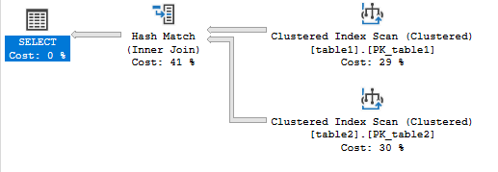
Foreign Keys Magic
I put 32000 rows in two tables.
SELECT table2.id
FROM table1 inner join table2
ON table1.id = table2.table1id;

Slide 15
Foreign Keys Magic
Now I’m going to add a Foreign Key
on Table2.table1id,
referencing table1.id.

Slide 16
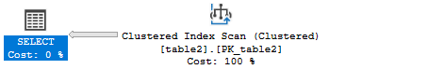
Foreign Keys Magic
Now, same query… keep your eye on the Clustered Index Scan on table1.
SELECT table2.id
FROM table1 inner join table2
ON table1.id = table2.table1id;

Slide 17
It’s Gone!
The Foreign Key allowed the scan on the parent table to vanish,
dropping the cost from 1.25 to 0.37
without changing code or indexes!

Slide 18
Spooky Story from SQLSat Pensacola ’12
I was giving a lightning talk,
not unlike this talk,
on night,
not unlike this night…
And this trick demo didn’t work.
Both scans stayed despite my FK. Why?

Slide 19
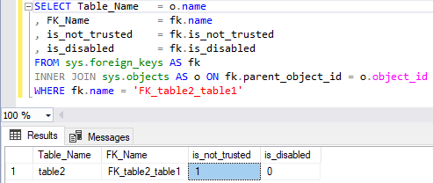
Foreign Keys Mystery
Later, I found the spook in my database.

Slide 20
Ever seen SSMS script out a FK like this?
ALTER TABLE dbo.table2 WITH NOCHECK ADD CONSTRAINT FK_table2_table1 FOREIGN KEY(table1id)
REFERENCES dbo.table1 (id);
FK is created but isn’t trusted.
It doesn’t evaluate existing rows,
and so it can’t help performance.

Slide 21
Mic Check Check
Instead of what normally follows:
ALTER TABLE dbo.table2
CHECK CONSTRAINT FK_table2_table1; What you need for a trusted FK is:
ALTER TABLE dbo.table2
WITH CHECK CHECK CONSTRAINT FK_table2_table1;
WITH. CHECK. CHECK. Seriously!

Slide 22
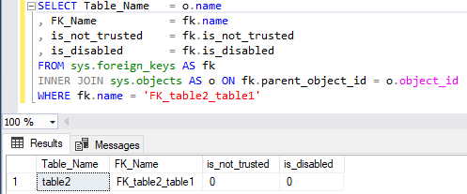
Now NOT not_trusted
After executing WITH CHECK CHECK, the FK is silently helping your queries again!

Slide 24
Fright #3
Behold, duplicate primary key horror!

Slide 25
Duplicate primary key entries?
Many businesses have an invoice or line item or reference num system that looks like this:
YearInvoice.LineItem
For example:
2019000000100.001
2019000000100.002
2019000000100.003…

Slide 26
Float/real is a floating point
Approximate numeric data types that do not store the exact values
They store an extremely close approximation, rounding up.

Slide 27
You Were Warned
Only use float if the max precision of decimal (38 digits!) is insufficient and you’re also ok with rounded results!
Further warnings from Microsoft Docs:
“Avoid using float/real columns in WHERE clause, especially = and <> operators.” https://docs.microsoft.com/en-us/previous-versions/sql/sql-server-2008-r2/ms187912(v=sql.105)?redirectedfrom=MSDN

Slide 28
Float as PK
Lab - float as pk problems.sql

Slide 29
Thanks for your time!
Hopefully you are all not too scared to enjoy the rest of PASS Summit 2019!

